Slide 1
Case C.2 Bitcoin Mining – Oct 01 (ICS3C0)
Agenda
Case Study C.2 Bitcoin Mining
Begin Level 1 & 2 Today
Complete Level 3 Tomorrow
Marks Spreadsheet (Complete On Your Own Time)
Module B.2 Python Turtle
Python Beginners Workbook (Handout)
Case Study C.1 / Module B.1
Upcoming
Wednesday: Computer Hardware

Slide 2
Case C.2 Bitcoin Mining – Oct 01 (ICS4C0)
Agenda
Case Study C.2 Bitcoin Mining
Begin Level 1 & 2 Today
Complete Level 3 Tomorrow
Mod B.3 SWT Math Project
Complete Questions (See Module B.3)
Upcoming
Wednesday: Computer Hardware

Slide 3

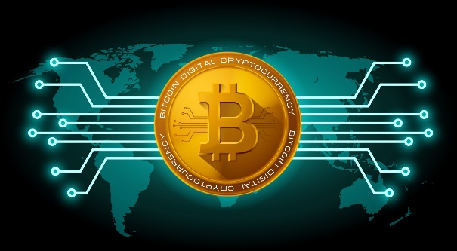
What is Bitcoin?
A digital currency
Encryption / Block Chain
Distributed Ownership / Peer to Peer Transactions
What is Bitcoin worth?
$8,400 CAD
How do you get Bitcoin?
Mining
E-Commerce
Why Bitcoin?
Security / Speed / Universality
Privacy / Not Controlled by a single Country or Company

